Slide 1

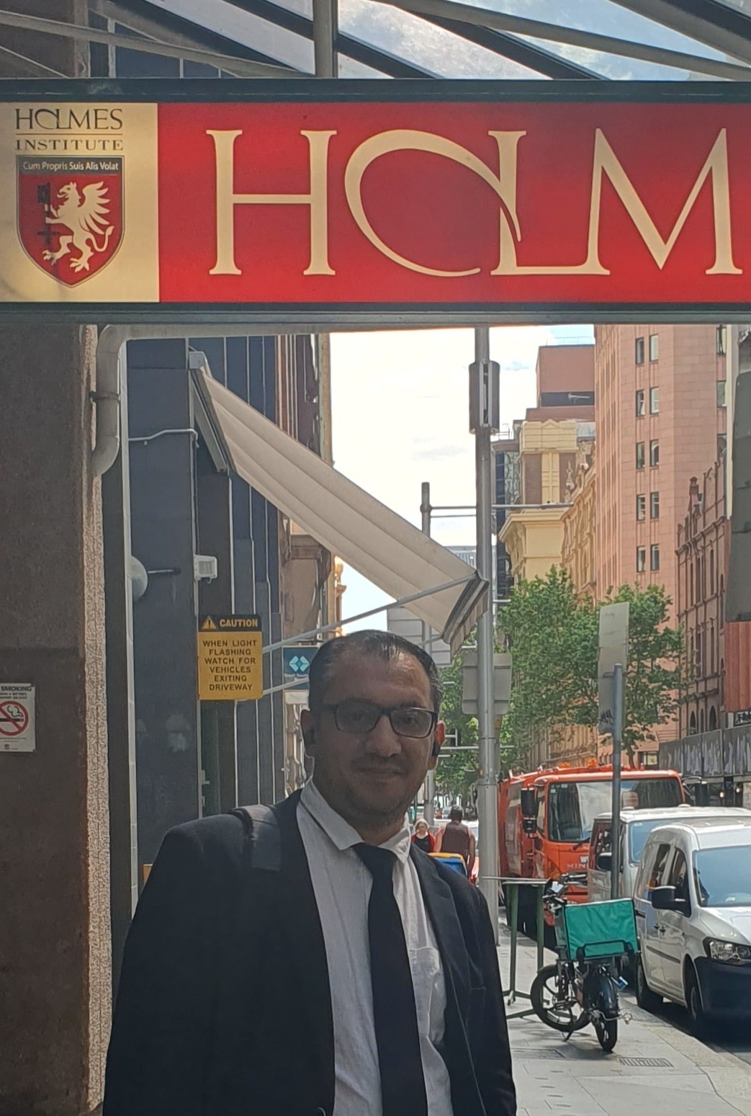
HI6040 (Artificial Intelligence and Machine Learning)
Dr. Farshid Keivanian
Tutorial Week 8

Slide 2
Outline
Preparation for Individual Assignment
Group Class Facilitation for HI6040-S1-T2.2025 (Sydney Campus)
What Students Should Do in Week 8
Example 1: Clustering the Iris Dataset: K-Means
Activity 1: Show the Cluster Centers in K-Means
Activity 2: Change the marker/size
Activity 3: Show centers for k=4
Activity 4: Compare sepal vs petal features
Activity 5: Change k and observe
Activity 6: Try different features
Activity 7: Standardize then cluster
Example 2: Choosing k: Elbow & Silhouette
Example 3: DBSCAN: Clustering by Density
Activity 8: Tune eps
Activity 9: Compare to K-Means
Activity 10: Standardization effect

Slide 3
Preparation for Individual Assignment
Step 1: Understand the Basics
Weight: 50% of your final grade.
Word Limit: 2000 words (±10%).
Due Date:
Gold Coast → 8 October 2025, 10:59 PM
Melbourne & Sydney → 8 October 2025, 11:59 PM
Submission Format:
Microsoft Word only (.docx).
Include completed Assignment Cover Sheet.
Submit via Blackboard (desktop/laptop only, not phone/tablet).
You have 3 attempts—only the final submission is marked.
Submissions in PDF or other formats, without cover sheet, or via mobile will not be accepted.

Slide 4
Preparation for Individual Assignment
Step 2: Choose a Topic
Select one from the list (or propose your own with approval). Examples include:
AI in Healthcare Diagnostics (accuracy vs. human oversight)
Generative AI in Content Creation (innovation vs. IP risk)
AI in Agriculture (precision farming & food security)
AI in Recruitment (mitigating algorithmic bias)
AI in Cybersecurity, Supply Chains, Finance, etc.
Choose a topic that you can find strong, relevant examples and literature for.

Slide 5
Preparation for Individual Assignment
Step 3: Structure Your Report (2000 words)
1. Introduction (150–200 words)
Introduce AI/ML in general and its role in business.
State the selected topic and why it is important.
Outline what your report will cover (scenario, solution, ethics).

Slide 6
Preparation for Individual Assignment
2. Business Scenario Analysis (600–700 words | 15 marks)
Describe the business context: industry, challenges, opportunities.
Identify key issues: e.g., inefficiency, bias, cost, lack of prediction, etc.
Evaluate how AI/ML can be applied: discuss specific use cases.
Discuss assumptions/limitations: e.g., data availability, cost, scalability.
Hint: Use case studies, research articles, or real company examples to strengthen your analysis.

Slide 7
Preparation for Individual Assignment
3. AI/ML Solution Proposal (800–900 words | 20 marks)
Outline the solution: AI/ML model or approach (e.g., predictive analytics, deep learning, NLP).
Relevance: Why is it suitable for the business problem?
Strategic considerations: alignment with business goals, scalability, integration with existing systems.
Expected benefits: efficiency, accuracy, customer experience, cost savings.
Challenges: technical, organizational, cost, training, regulatory.
High-level implementation plan: focus on strategy (not coding/algorithms).
Hint: Include diagrams, frameworks, or strategic roadmaps if relevant.

Slide 8
Preparation for Individual Assignment
4. Ethical & Philosophical Considerations (300–400 words | 10 marks)
Identify ethical issues: bias, fairness, transparency, privacy, job displacement.
Philosophical concerns: Should AI make decisions without human oversight?
Propose solutions: policies, human-in-the-loop, ethical AI frameworks.
Hint: Link to real controversies or case studies (e.g., bias in recruitment tools, ChatGPT & plagiarism, autonomous weapons).

Slide 9
Preparation for Individual Assignment
5. Conclusion (150–200 words)
Summarise the key findings.
Re-emphasize the strategic value of your solution.
Briefly highlight future directions.

Slide 10
Preparation for Individual Assignment
6. References
Use Holmes Adapted Harvard Referencing.
Minimum: 10–12 high-quality academic sources (journals, books, reputable industry reports).
Avoid over-reliance on blogs/websites.
Outside sources cannot exceed 10% of content.

Slide 11
Preparation for Individual Assignment
Step 4: Writing & Formatting Guidelines
Font: Times New Roman or Arial, size 12, 1.5 spacing.
Clear section headings.
Write in formal academic style (avoid “I think”, casual tone).
Proofread for grammar, spelling, and flow.

Slide 12
Preparation for Individual Assignment
Step 5: What NOT to Do
Don’t submit in PDF or any format other than Word.
Don’t forget the cover sheet.
Don’t copy-paste from sources (plagiarism = heavy penalties).
Don’t rely only on non-academic sources (Wikipedia, blogs).
Don’t leave referencing incomplete.

Slide 13
Preparation for Individual Assignment
Step 6: Hints for High Marks
Use real-world business cases (e.g., IBM Watson in healthcare, Tesla in logistics).
Critically evaluate both strengths and weaknesses of AI/ML.
Show awareness of strategic impact, not just technical features.
Include ethical depth (privacy, accountability, future of work).
Write logically with smooth transitions between sections.

Slide 14
Preparation for Individual Assignment
Final Checklist Before Submission
Microsoft Word format (.docx)
Cover Sheet included
Word count approx. 2000 (+/- 10%)
Proper referencing (Holmes Harvard style)
Submitted on Blackboard (desktop/laptop only)
Reviewed Turnitin similarity report before final submission

Slide 15
Preparation for Individual Assignment
Do students need to code?
The assignment is focused on strategic evaluation and proposal, not technical implementation.
Here’s why:
The brief says: “This proposal should focus on the strategic application and expected outcomes rather than technical implementation.”
The marking criteria assess analysis, solution proposal, ethical considerations, and report quality — not coding or algorithm development.
You’re expected to explain what kind of AI/ML could be applied, why it fits, and what impact it would have — not to build or program the model.
Students may use examples of algorithms or models (e.g., decision trees, CNNs, NLP models) to illustrate their solution, but only at a conceptual/strategic level, not by coding or providing datasets.

Slide 16
Preparation for Individual Assignment
In short:
No coding required.
Focus on business context, strategic solution design, benefits, challenges, ethics.
Support arguments with literature, case studies, and examples.

Slide 17
Group Class Facilitation for HI6040-S1-T2.2025 (Sydney Campus)
For the Group Class Facilitation assessment (worth 30%), your group must select a topic and email it to me for approval.
In addition, each group must book a time slot for your presentation session. Please use the following link to book your slot:
Presentation Schedule for HI6040-2025 (Sydney S1).xlsx

Slide 18
Group Class Facilitation for HI6040-S1-T2.2025 (Sydney Campus)
Important guidelines:
Each group must choose a topic (from the proposed AI/ML areas) and obtain approval by email.
Time slots are allocated on a first-come, first-served basis.
Enter your group’s details directly into the booking sheet.
Each group presents only once, in their allocated week (Weeks 5–11).
Each student is expected to present for about 5 minutes.
Your slides must be submitted on Blackboard before your facilitation session (one submission per group).
After booking, please send me a confirmation email.

Slide 19
What Students Should Do in Week 8
Prepare one slide (as per the group assessment) with:
A short example of unsupervised learning (preferably clustering).
A simple diagram, dataset visualization, or result (scatter plot).
2–3 questions for class discussion (not just answers).
A 2-minute summary of what they learned.

Slide 20
What Students Should Do in Week 8
Present a simple case:
Load data (e.g., Iris dataset from sklearn).
Run K-Means clustering or PCA (dimensionality reduction).
Show the result visually (clusters on a scatter plot).

Slide 21
Example 1: Clustering the Iris Dataset: K-Means
Goal: Group flowers into 3 clusters without labels.
Tool: K-Means (partition data into k groups by minimizing distance to each group’s center).
Data: Iris sepal length & width (2 features so we can plot).

Slide 22
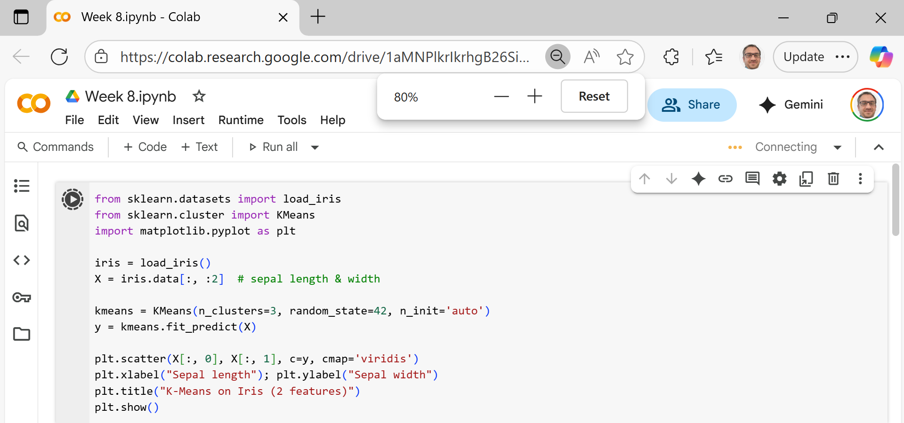
Example 1: Clustering the Iris Dataset: K-Means
Load data → get two columns (sepal length/width).
Pick k → we choose k = 3 (we expect 3 species).
Fit K-Means → the algorithm places 3 centers, assigns each point to the nearest center, and repeats until centers stop moving.
Get labels → each point now has a cluster ID (0/1/2).
Plot → color points by their cluster to see the groups.

Slide 23
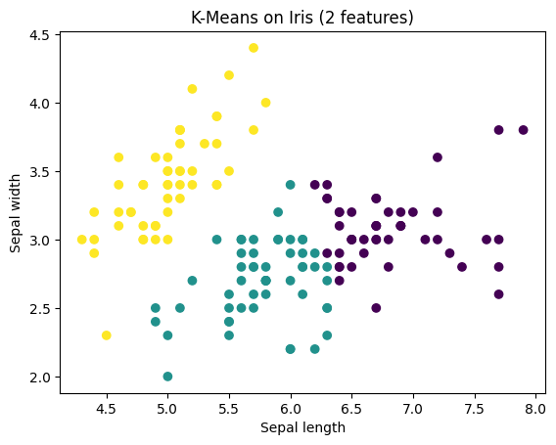
Example 1: Clustering the Iris Dataset: K-Means
Explain of Results:
Each color = a cluster found by K-Means.
Centers (not shown) are the “average” point of each cluster.
K-Means works best when clusters are roundish and similar size

Slide 24

Activity 1: Show the Cluster Centers in K-Means
Activity Prompt (for students)
You have a scatter plot of Iris clusters.
But… where are the cluster centers?
Think: What line of code could you add to mark them with a red “X”? (Hint: the fitted KMeans object has something stored about centers…)

Slide 25
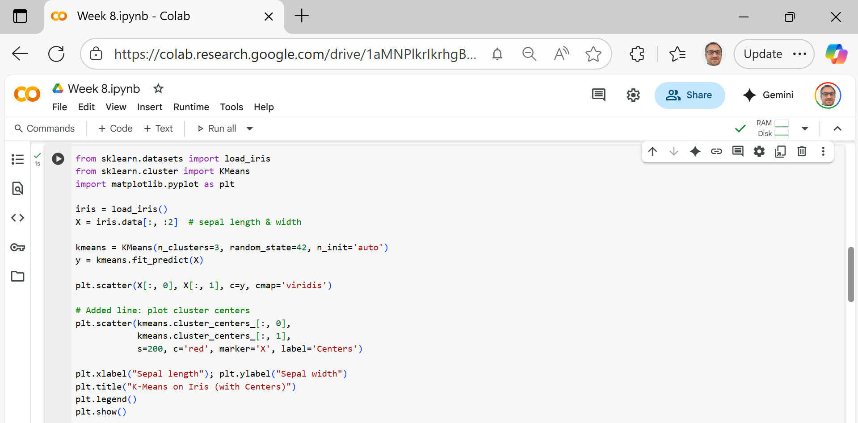
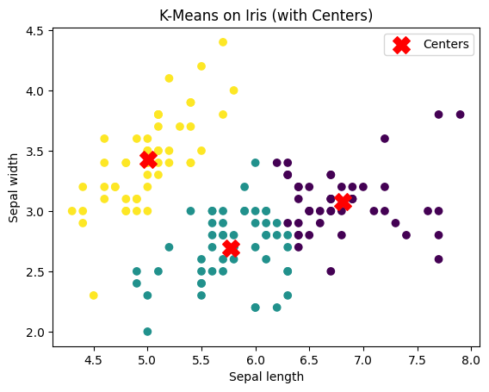
Activity 1: Show the Cluster Centers in K-Means
New Line
kmeans.cluster_centers_ → stores the coordinates of the cluster centers.
[:, 0] and [:, 1] → grab the x and y coordinates.
s=200 → makes the marker bigger.
c='red', marker='X' → makes centers stand out as red X’s.
label='Centers' → so the legend explains what the X’s are.

Slide 26
Activity 2: Change the marker/size
Try marker='*', s=300.
Question: Which is easier to see, star or X?

Slide 27
Activity 3: Show centers for k=4
Change n_clusters=4.
Question: How many centers appear? Where are they?

Slide 28
Activity 4: Compare sepal vs petal features
Plot again with iris.data[:, 2:4].
Question: Do the cluster centers move closer to “real species” separation?

Slide 29
Activity 5: Change k and observe
Try n_clusters=2, then 4.
What to note: With too few clusters, groups mix; with too many, one natural group gets split.

Slide 30
Activity 6: Try different features
Use petal features: iris.data[:, 2:4].
What to note: Petal features separate species more clearly → cleaner clusters.

Slide 31
Activity 7: Standardize then cluster
from sklearn.preprocessing import StandardScaler
Xz = StandardScaler().fit_transform(iris.data[:, :2])
y2 = KMeans(n_clusters=3, random_state=42, n_init='auto').fit_predict(Xz)
What to note: Scaling avoids one feature dominating distance.

Slide 32
Example 2: Choosing k: Elbow & Silhouette
How Many Clusters? Elbow + Silhouette on Iris
Try many k values (e.g., 2–8).
Elbow: Record inertia (sum of squared distances). Plot inertia vs k → look for the “elbow” (diminishing returns).
Silhouette: Score how well points fit their cluster vs. others (−1 to 1). Higher is better.
Why we do this
K-Means needs you to choose k (the number of clusters).
But how do we know the best k?
Two popular ways: Elbow (look for bend in error curve) and Silhouette (score cluster quality).

Slide 33
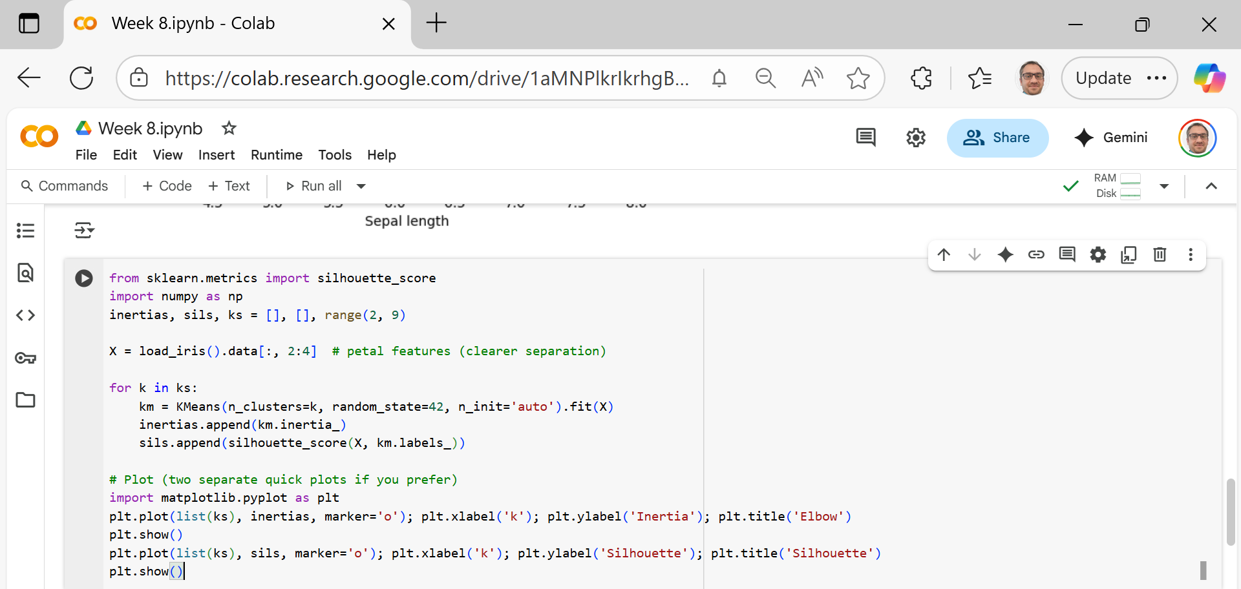
Prepare data
Use only petal length & width → easier to see separation.
Try different k values
Loop k = 2 to 8.
For each k:
Run K-Means.
Save the inertia (distance of points to their centers).
Save the silhouette score (how well points fit in their cluster vs others).

Slide 34
Plot Elbow
Inertia decreases as k increases.
The “elbow point” (bend in the line) suggests a good k.
Plot Silhouette
Higher silhouette score = better clustering.
The best k usually has the highest score.

Slide 35
Key Takeaways for Students
Elbow method: Too few clusters → error high; too many clusters → no big improvement.
Silhouette method: Balances cohesion (tight clusters) and separation (clusters far apart).
On Iris petals, both usually point to k ≈ 3.

Slide 36
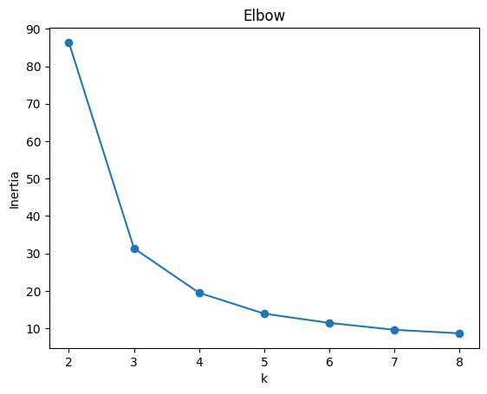
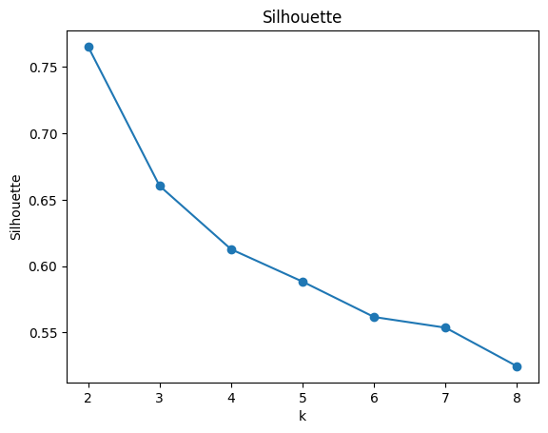
Elbow plot: The biggest drop in inertia happens from k=2 → k=3. After k=3, the curve flattens, meaning extra clusters don’t add much value.
Silhouette plot: The score is highest at k=2, but k=3 is also strong and aligns better with the natural three Iris species.
Conclusion: Both methods suggest k=3 is a good balance (close to biology), even though silhouette peaks at 2.
Why might silhouette suggest 2 but elbow suggest 3? Which would you trust here?

Slide 37
Example 3: DBSCAN: Clustering by Density
DBSCAN: Find Clusters (and Noise) Without Choosing k
Why this example
No need to choose k.
Finds oddly shaped clusters and can mark noise.
Shows contrast with K-Means’ round-cluster bias.

Slide 38
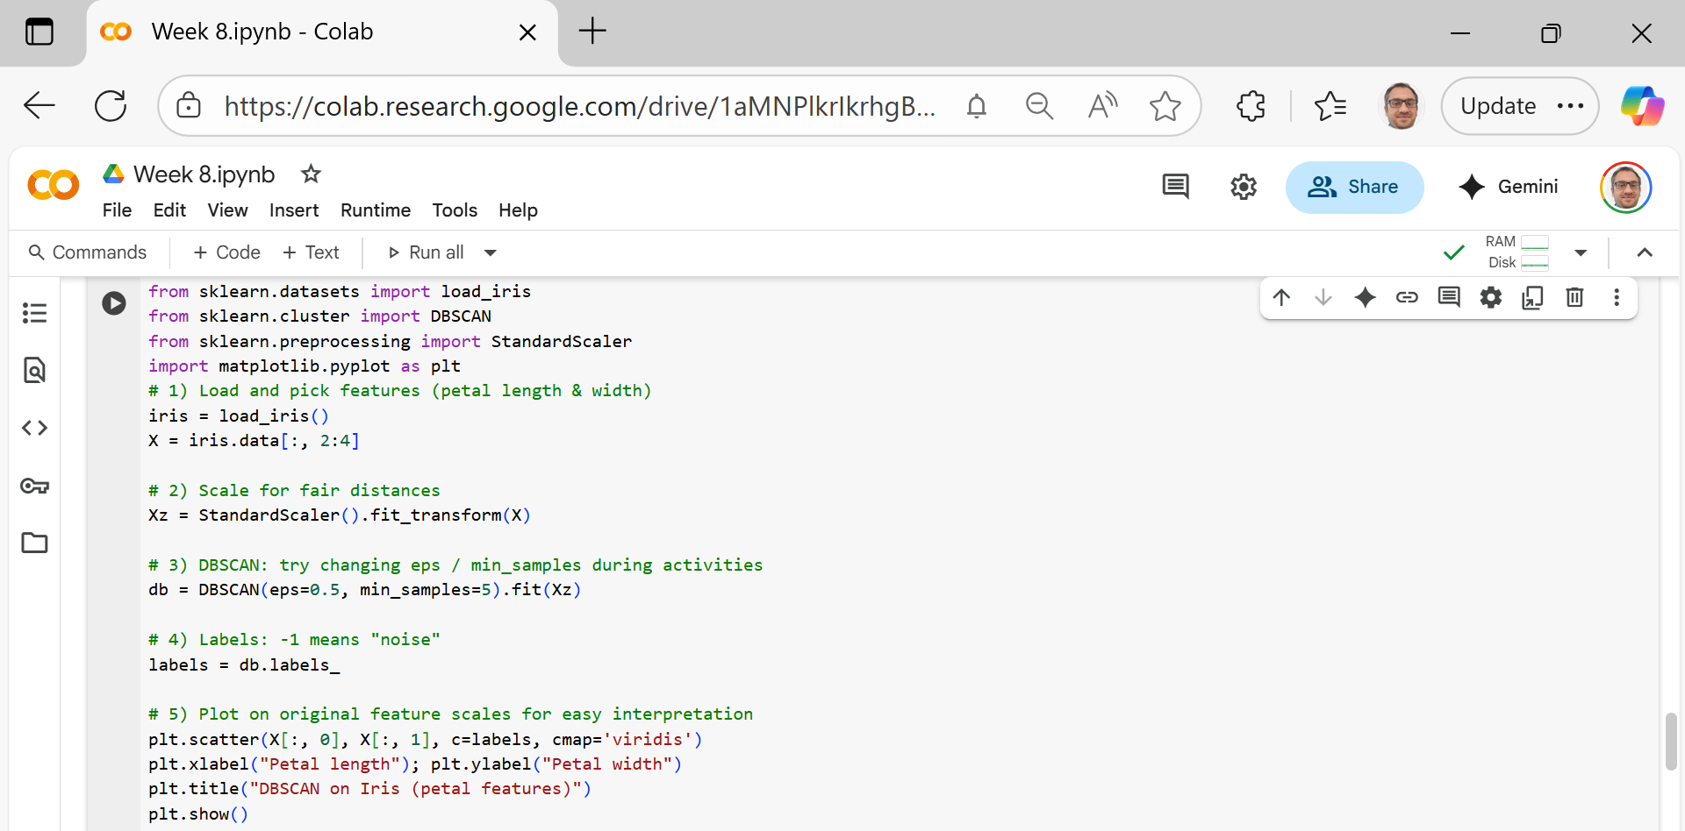
Load data Use Iris petal length & width (they separate species better).
Scale features DBSCAN uses distances. We standardize so both features contribute fairly.
Pick DBSCAN knobs
eps: how close points must be to be “neighbors” (radius in scaled units).
min_samples: how many neighbors make a spot “dense” (including itself).

Slide 39
Run DBSCAN It groups points in dense areas into clusters; sparse points become noise.
Read labels labels = db.labels_ → cluster IDs 0,1,…; noise = −1.
Plot Show petal length (x) vs petal width (y), color by labels to see clusters/noise.

Slide 40
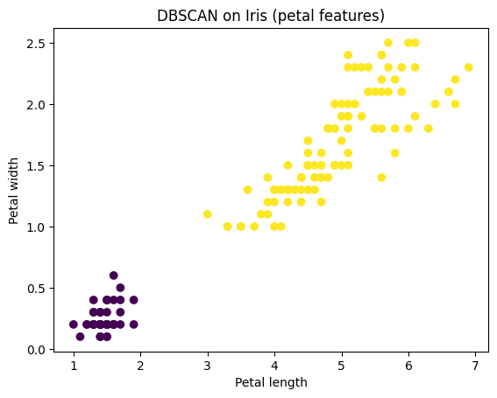
DBSCAN found two main clusters in the Iris petal data — one small, tight cluster on the left and one larger cluster on the right — showing it can group dense regions without needing you to set k in advance.

Slide 41
Activity 8: Tune eps
Do: Try eps = 0.3, 0.5, 0.7.
Notice: Smaller eps → more clusters/noise; larger eps → clusters merge.

Slide 42
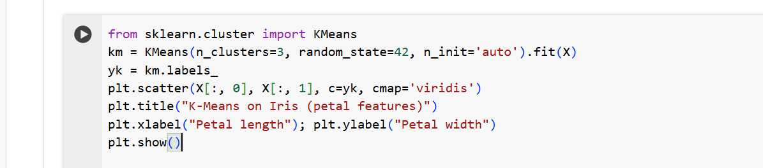
Activity 9: Compare to K-Means
Do: Run K-Means on the same features (X) and plot its labels.
Notice: K-Means forces exactly k clusters; DBSCAN can find shapes and mark noise.

Slide 43
Activity 10: Standardization effect
Do: Run DBSCAN without scaling (use X instead of Xz), then with scaling.
Notice: Results change a lot without scaling → distance-based methods need scaling.

Slide 44
Thank You
Need Help with coding? Send an email or ask during the tutorial session.
FKeivanian@my.holmes.edu.au

